Slide 1

Data Mining – Meeting 1
Roi Yehoshua
Partially Based on slides of Noam Koenigstein The Open University

Slide 2
Agenda
Administration
Overview of the field
Weka software
Concepts in information theory

Slide 3
Me
My name is Roi Yehoshua
PhD candidate in Computer Science (Robotics) at Bar Ilan University
At Bar-Ilan I teach Introduction to Robotics and Multi-Robot Systems
At OpenU I teach Biological Computation, Data Mining and Numerical Analysis courses
Home page: http://u.cs.biu.ac.il/~yehoshr1/

Slide 4
Help and Support
roi.yehoshua@openu.ac.il
Remote reception hour:
Tuesday 21:30-22:30
You may call the other instructors

Slide 5
Requirements
4 assignments:
2 small (choice) – maman 11 and 12. 2 points each
Project divided to 2 parts (mandatory) – maman 21 and 22. 13 points each
Exam
Grade: The assignments are 26-30% of the grade.

Slide 6
Data Mining
Data mining is the computational process of discovering patterns in large data sets
Patterns should be valid, novel, potentially useful and ultimately understandable
The overall goal of the data mining process is to extract information from a data set and transform it into an understandable structure for further use

Slide 7
What’s involved
Machine learning
Pattern recognition
Machine Learning/
Pattern Recognition
Statistics/ AI
Data Mining
Database systems

Slide 8
Why Data Mining?
Huge amounts of data being collected and warehoused
Walmart records 20 millions per day
Health care transactions: multi-GB databases
Mobil Oil: geological data of over 100 TB
Competitive pressure
Gain an edge by providing improved, customized services

Slide 9
Lots and lots of data
Credit card transactions
Shopping lists
Algo trading
Movies/books/music preferences
CRM – behaviors of costumers
Behavior of viruses and germs
Behavior of cancer cells
Communication patterns (terror cells)
Notes:
CRM – Customer Relationship Management

Slide 10
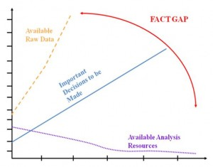
The Facts Gap
Taken from http://www.stics.com/tag/data-segmentation/
Notes:
CRM – Customer Relationship Management

Slide 11
KDD – Knowledge Discovery In Databases
Knowledge Discovery in Databases (KDD) is “the nontrivial process of identifying valid, novel, potentially useful, and ultimately understandable patterns in data”.
Data mining is a step in the KDD process of applying data analysis and discovery algorithms
Notes:
CRM – Customer Relationship Management

Slide 12
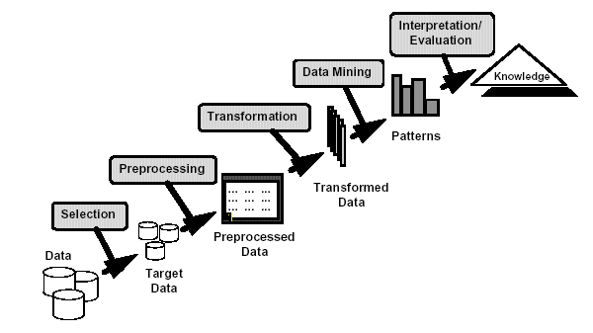
The KDD process
Taken from Han & Kamber, Data Mining Book

Slide 13
KDD Basic Steps
Identifying the objectives of the KDD Process
classification
estimation
rule extraction, etc.
Data selection
Selecting / creating a target data set in a database
Focusing on a subset of data samples
Cleaning and pre-processing of target data
Removing noisy and erroneous data
Handling missing data values
Notes:
Expenditure -

Slide 14
KDD Basic Steps
Dimensionality reduction and transformation
Selecting most important features (attributes)
Defining new (calculated) attributes
Data Mining
Selecting DM methods and tools
Matching data representation to a particular method (e.g., discretization)
Model selection (e.g., defining class attributes)
Knowledge extraction
Notes:
Expenditure -

Slide 15
KDD Basic Steps
Pattern Evaluation
Restoring metadata
Visualization of results
Evaluation of discovered patterns by:
statistical significance, interestingness, importance, relevance, actionability, etc.
If necessary: returning to previous steps
Conclusions
Choosing action(s)
Notes:
Expenditure -

Slide 16
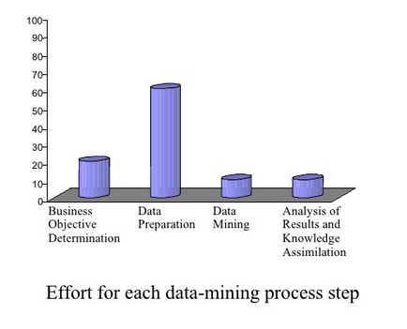
Efforts For Each Data Mining Step
Taken from http://www.docstoc.com/docs/15895288/
Notes:
Expenditure -

Slide 17
Issues And Challenges
Large Data
Number of variables (features / dimensions), number of instances (cases)
Multi gigabyte, terabyte databases
Efficient algorithms, parallel processing
High dimensionality
Potential for spurious patterns
Dimensionality reduction
Overfitting
Models noise in training data, rather than just the general patterns
Notes:
Expenditure -

Slide 18
Issues And Challenges
Changing data, missing and noisy data
Use of domain knowledge
Utilizing knowledge on complex data relationships, known facts
Understandability of patterns
Notes:
Expenditure -

Slide 19
What type of knowledge?
Prediction Methods
Use some variables to predict unknown or future values of other variables.
Description Methods
Find human-interpretable patterns that describe the data.

Slide 20
Types of DM Tasks
Classification [Predictive]
Clustering [Descriptive]
Association Rule Discovery [Descriptive]
Sequential Pattern Discovery [Descriptive]
Regression [Predictive]
Deviation Detection [Predictive]

Slide 21
Classification: Definition
Given a collection of records (training set )
Each record contains a set of attributes, one of the attributes is the class.
Find a model for class attribute as a function of the values of other attributes.
Goal: previously unseen records should be assigned a class as accurately as possible.
A test set is used to determine the accuracy of the model. Usually, the given data set is divided into training and test sets, with training set used to build the model and test set used to validate it.

Slide 22
Classification Example
categorical
categorical
continuous
class
Test
Set
Learn
Classifier
Training
Set
Model
Taken from http://www.docstoc.com/docs/15895288/

Slide 23
Classification: Application 1
Direct Marketing
Goal: Reduce cost of mailing by targeting a set of consumers likely to buy a new cell-phone product.
Approach:
Use the data for a similar product introduced before.
We know which customers decided to buy and which decided otherwise. This {buy, don’t buy} decision forms the class attribute.
Collect various demographic, lifestyle, and company-interaction related information about all such customers.
Type of business, where they stay, how much they earn, etc.
Use this information as input attributes to learn a classifier model.
From [Berry & Linoff] Data Mining Techniques, 1997

Slide 24
Classification: Application 2
Fraud Detection
Goal: Predict fraudulent cases in credit card transactions.
Approach:
Use credit card transactions and the information on its account-holder as attributes.
When does a customer buy, what does he buy, how often he pays on time, etc
Label past transactions as fraud or fair transactions. This forms the class attribute.
Learn a model for the class of the transactions.
Use this model to detect fraud by observing credit card transactions on an account.

Slide 25
Classification: Application 3
Sky Survey Cataloging
Goal: To predict class (star or galaxy) of sky objects, especially visually faint ones, based on the telescopic survey images (from Palomar Observatory).
3000 images with 23,040 x 23,040 pixels per image.
Approach:
Segment the image.
Measure image attributes (features) - 40 of them per object.
Model the class based on these features.
Success Story: Could find 16 new high red-shift quasars, some of the farthest objects that are difficult to find!
From [Fayyad, et.al.] Advances in Knowledge Discovery and Data Mining, 1996

Slide 26
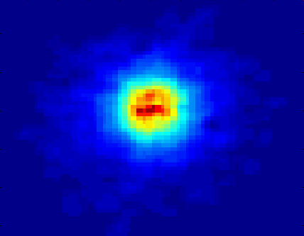
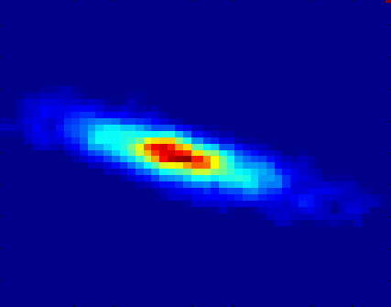
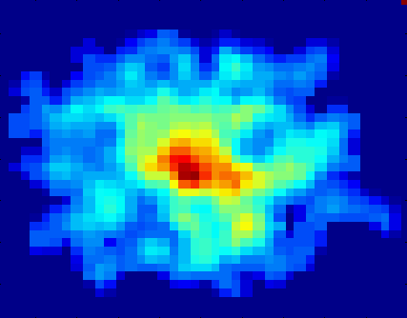
Classifying Galaxies
Courtesy: http://aps.umn.edu
Early
Class:
Stages of Formation
Attributes:
Image features,
Characteristics of light waves received, etc.
Intermediate
Late
Data Size:
72 million stars, 20 million galaxies
Object Catalog: 9 GB
Image Database: 150 GB
Taken from: Oren Tsur, Data Mining, spring 2010

Slide 27
Regression
Predict a value of a given continuous valued variable based on the values of other variables, assuming a linear or nonlinear model of dependency.
Greatly studied in statistics, neural network fields.
Examples:
Predicting sales amounts of new product based on advertising expenditure.
Predicting wind velocities as a function of temperature, humidity, air pressure, etc.
Time series prediction of stock market indices.
Notes:
Expenditure -

Slide 28
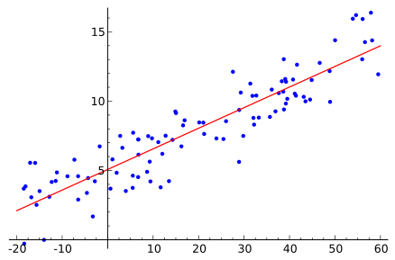
Linear Regression
Taken from wikipedia
Notes:
Expenditure -

Slide 29
Association Rule Discovery: Definition
Given a set of records each of which contain some number of items from a given collection;
Produce dependency rules which will predict occurrence of an item based on occurrences of other items.
Rules Discovered:
{Milk} --> {Coke}
{Diaper, Milk} --> {Beer}

Slide 30
Clustering Definition
Given a set of data points, each having a set of attributes, and a similarity measure among them, find clusters such that
Data points in one cluster are more similar to one another.
Data points in separate clusters are less similar to one another.
Similarity Measures:
Euclidean Distance if attributes are continuous.
Other Problem-specific Measures.

Slide 31
Illustrating Clustering
Euclidean Distance Based Clustering in 3-D space.
Intracluster distances
are minimized
Intercluster distances
are maximized

Slide 32
Clustering: Application 1
Market Segmentation:
Goal: subdivide a market into distinct subsets of customers where any subset may conceivably be selected as a market target to be reached with a distinct marketing mix.
Approach:
Collect different attributes of customers based on their geographical and lifestyle related information.
Find clusters of similar customers.
Measure the clustering quality by observing buying patterns of customers in same cluster vs. those from different clusters.

Slide 33
Clustering: Application 2
Document Clustering:
Goal: To find groups of documents that are similar to each other based on the important terms appearing in them.
Approach: To identify frequently occurring terms in each document. Form a similarity measure based on the frequencies of different terms. Use it to cluster.
Gain: Information Retrieval can utilize the clusters to relate a new document or search term to clustered documents.

Slide 34
Illustrating Document Clustering
Clustering Points: 3204 Articles of Los Angeles Times.
Similarity Measure: How many words are common in these documents (after some word filtering).
Taken from: Noam Koenigstein , Data Mining, spring 2011

Slide 35
Clustering of S&P 500 Stock Data
Observe Stock Movements every day.
Clustering points: Stock-{UP/DOWN}
Similarity Measure: Two points are more similar if the events described by them frequently happen together on the same day.

Slide 36
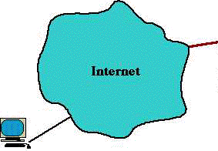
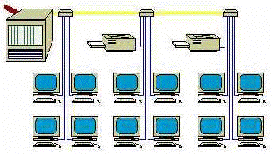
Deviation/Anomaly Detection
Detect significant deviations from normal behavior
Applications:
Credit Card Fraud Detection
Network Intrusion Detection
Typical network traffic at University level may reach over 100 million connections per day
Taken from: Noam Koenigstein , Data Mining, spring 2011

Slide 37
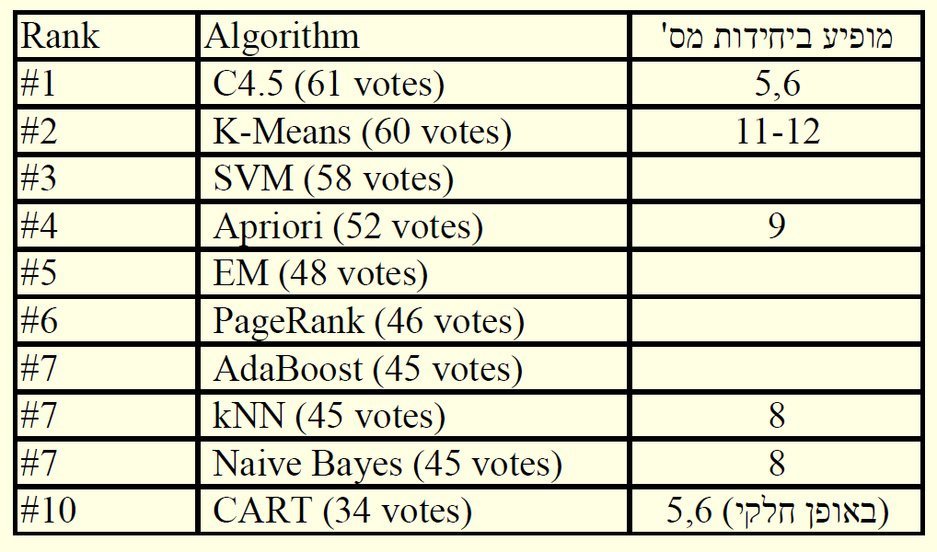
TOP-10 ALGORITHMS
Taken from: Han & Kamper, Data Mining Book
Notes:
Expenditure -

Slide 38
DATA WAREHOUSE
A subject-oriented, integrated, time-variant, and non-volatile collection of data in support of management’s decision making.
Subject-Oriented: production floor control, marketing, purchasing, QC, etc.
Integrated: encoding, measurement units, naming conventions, key structures.
Time-Variant: long time horizon, time keys.
Nonvolatile: no updates of data (only data loading and data access).
Notes:
Expenditure -

Slide 39
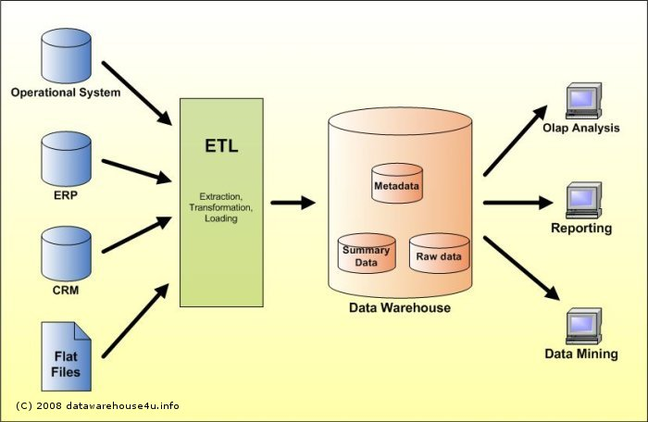
DATA WAREHOUSE
Taken from http://datawarehouse4u.info/
Notes:
Expenditure -

Slide 40
OLTP vs. OLAP
OLTP – Online Transactional Processing
deals with operational data, which is data involved in the operation of a particular system and it is characterized by a large number of short on-line transactions (INSERT, UPDATE, and DELETE)
OLAP – Online Analytical Processing
deals with Historical Data or Archival Data, and it is characterized by relatively low volume of transactions
Notes:
Expenditure -

Slide 41
OLTP vs. OLAP
Data Warehouse | OLTP
Management | Front-line workers | Users
Supports strategic decisions | Supports day-to-day operations | Purpose
Filtered and transformed data | Raw data (entered by users) | Data
Internal and external sources | Internal sources only | Sources of data
Historical data | Current data | Time Horizon
Detail and summary data | Only detail data | Level of data
De-normalized tables | 3NF | Data structure
Maximum query efficiency | Maximum update efficiency | Design goal
Notes:
Expenditure -

Slide 42
OLAP Data Cube
An OLAP cube is a multidimensional database that is optimized for data warehouse and online analytical processing (OLAP) applications.
In OLAP cubes, data (measures) are categorized by dimensions.
OLAP cubes are often pre-summarized across dimensions to drastically improve query time over relational databases.
Notes:
Expenditure -

Slide 43
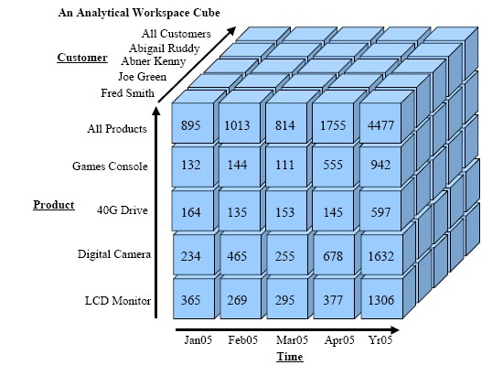
OLAP Data Cube
Taken from: http://gerardnico.com/wiki/database/oracle/oracle_olap
Notes:
Expenditure -

Slide 44
TYPICAL OLAP OPERATIONS
Roll up (drill-up): summarize data
by climbing up hierarchy or by dimension reduction
Drill down (roll down): reverse of roll-up
from higher level summary to lower level summary or detailed data, or introducing new dimensions
Slice and dice: project and select
Pivot (rotate):
reorient the cube, visualization, 3D to series of 2D planes
Other operations
drill across: involving (across) more than one fact table
drill through: through the bottom level of the cube to its back-end relational tables (using SQL)
Notes:
Expenditure -

Slide 45
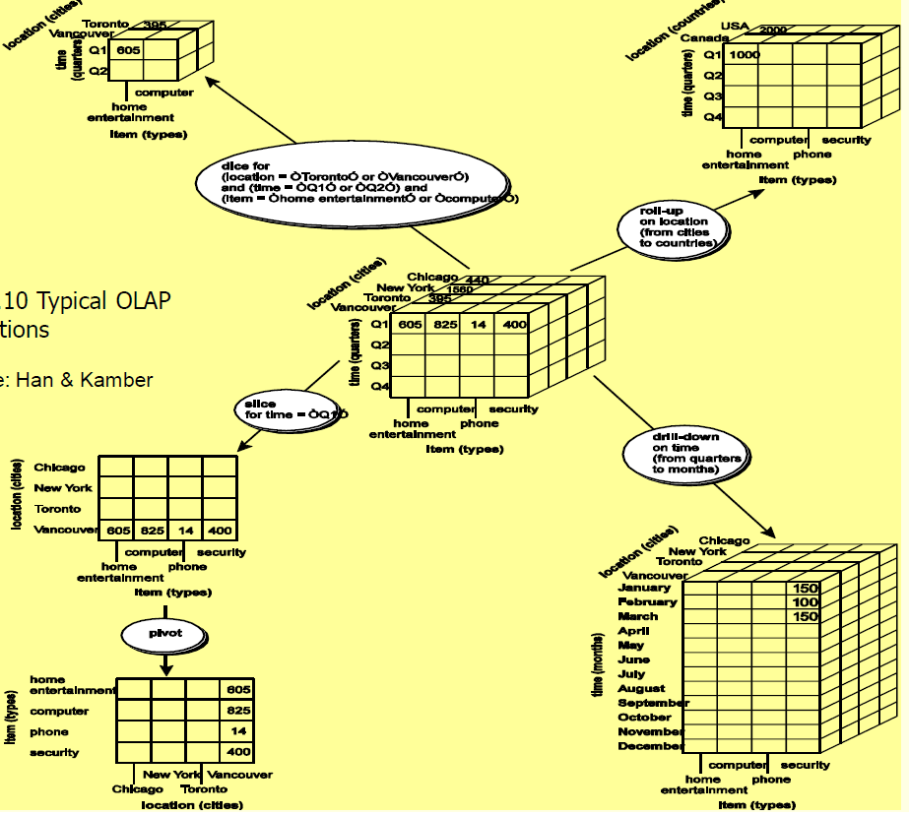
TYPICAL OLAP OPERATIONS
Taken from: Han & Kamper, Data Mining Book
Notes:
Expenditure -

Slide 46

WEKA
Weka (Waikato Environment for Knowledge Analysis) is a popular suite of machine learning software developed at the University of Waikato, New Zealand
Weka supports several standard data mining tasks, more specifically, data preprocessing, clustering, classification, regression, visualization, and feature selection
Download from
http://www.cs.waikato.ac.nz/~ml/weka/

Slide 47
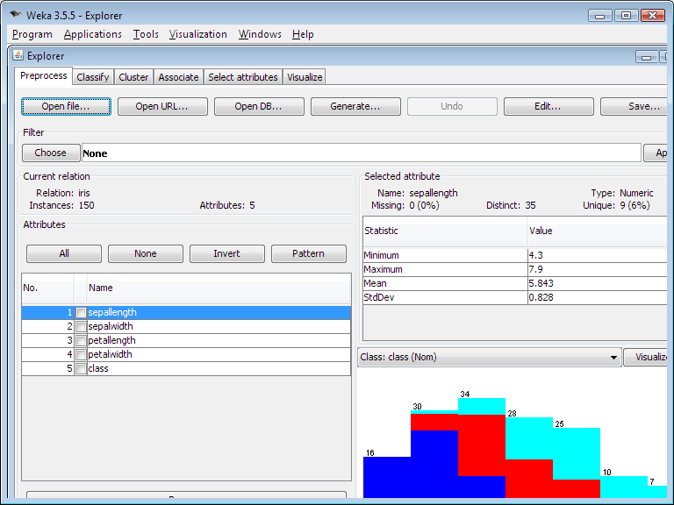
Weka

Slide 48
Classic Data Sets
Several classic datasets have been used extensively in the statistical literature:
Iris flower data set - multivariate dataset introduced by Ronald Fisher (1936).
diabetes data set - Pima Indians Diabetes Database
The Bupa liver data, used in several papers in the machine learning (data mining) literature
Repository of data sets
http://repository.seasr.org/Datasets/UCI/arff/

Slide 49
Information Theory

Slide 50
Information and Uncertainty
A mathematical Theory of Communication, by Claude Shannon, Bell labs.
Uncertainty is our limited knowledge about the outcome of some (future) event
Examples:
Credit card transaction (legitimate/fraudlent)
A customer moving to a new service provider (outcome = new provider)
Grade point average of a graduating student (outcome = value between 0 and 100)

Slide 51
Information and Uncertainty
If the outcome of an event can be predicted with 100% accuracy, then the uncertainty of an event is 0
The uncertainty of event increases with the number of possible outcomes
For the same number of outcomes, the uncertainty is maximal if each outcome has the same probability

Slide 52

Entropy
Definition: entropy is a measure of the uncertainty associated with random variable X.
I(x_{i}) is the information content of x_{i}
Usually the base of logarithm is b = 2. In that case the unit of entropy is bit.

Slide 53
Properties Of Entropy
H(X) = 0 if and only if the outcome is deterministic (all p(x) but one are zero)
H(X) ≤ log [number of outcomes].
H(X) is maximum when all outcomes have the same probability
If all the outcomes have the same probability, then H(X) is a monotonic increasing function of the number of outcomes

Slide 54
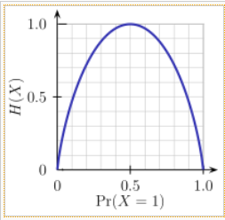
The Binary Case
1
The entropy of flipping a fair coin?
The entropy of flipping an unfair coin?
Which has a better entropy?
If we know that p(x=head) = 1/3
H(X) = -[1/3*log1/3+2/3*log2/3] = ~0.9
If we know that p(x=head) = 1/10
H(X) = -[1/10*log1/10+9/10*log9/10] = ~0.476

Slide 55

The entropy of a fair dice roll?
X = {1,2,3,4,5,6}
P(X=x) = 1/6
H(X) = -6*(1/6*log1/6) = - log1/6 = log6 = 2.585
Unified distribution means less certainty.
Bigger sample space means less certainty

Slide 56
Conditional Entropy
Goal: measure uncertainty of Y, when X is given
Conditional entropy of Y given X is:
Another definition – the average conditional entropy of Y:

Slide 57
Conditional Entropy
Properties of conditional entropy:
The uncertainty of Y is never increased by knowledge of X:
If X and Y are independent then

Slide 58
Entropy H(*)
X = College Major
Y = Likes “XBOX”
H(X) = 1.5
X | Y
Math | Yes
History | No
CS | Yes
Math | No
Math | No
CS | Yes
History | No
Math | Yes
H(Y) =
58
Slides taken from: Jimeng Sun Machine Learning (Recitation 1)

Slide 59
Specific Conditional Entropy H(Y|X=v)
Definition of Specific Conditional Entropy:
H(Y |X=v) = The entropy of Y among only those records in which X has value v
X = College Major
Y = Likes “XBOX”
X | Y
Math | Yes
History | No
CS | Yes
Math | No
Math | No
CS | Yes
History | No
Math | Yes
59
Slides taken from: Jimeng Sun Machine Learning (Recitation 1)

Slide 60
Conditional Entropy H(Y|X)
Definition of Conditional Entropy:
H(Y |X) = The average specific conditional entropy of Y
= if you choose a record at random what will be the conditional entropy of Y, conditioned on that row’s value of X
= Expected number of bits to transmit Y if both sides will know the value of X
= Σ_{j} Prob(X=v_{j}) H(Y | X = v_{j})
X = College Major
Y = Likes “XBOX”
X | Y
Math | Yes
History | No
CS | Yes
Math | No
Math | No
CS | Yes
History | No
Math | Yes
60
Slides taken from: Jimeng Sun Machine Learning (Recitation 1)

Slide 61
Conditional Entropy
Definition of Conditional Entropy:
H(Y|X) = The average conditional entropy of Y
= Σ_{j}Prob(X=v_{j}) H(Y | X = v_{j})
X = College Major
Y = Likes “XBOX”
X | Y
Math | Yes
History | No
CS | Yes
Math | No
Math | No
CS | Yes
History | No
Math | Yes
Example:
v_{j} | Prob(X=v_{j}) | H(Y | X = v_{j})
Math | 0.5 | 1
History | 0.25 | 0
CS | 0.25 | 0
61
H(Y|X) = 0.5 * 1 + 0.25 * 0 + 0.25 * 0 = 0.5
Slides taken from: Jimeng Sun Machine Learning (Recitation 1)

Slide 62
Mutual Information
Goal: measure reduction in the uncertainty of Y as a result of knowing X
Properties of Mutual Information:
Symmetry I(X;Y) = I(Y;X)
Mutual information is non-negative I(X;Y) ≥ 0
If X and Y are independent, then I(X;Y) = 0

Slide 63
Mutual Information
X = College Major
Y = Likes “XBOX”
Example:
H(Y) = 1
H(Y|X) = 0.5
Thus IG(Y|X) = 1 – 0.5 = 0.5
X | Y
Math | Yes
History | No
CS | Yes
Math | No
Math | No
CS | Yes
History | No
Math | Yes
63
Slides taken from: Jimeng Sun Machine Learning (Recitation 1)

Slide 64

Entropy and compression
Shannon entropy provides an absolute limit on the best possible lossless encoding or compression of any communication
Shannon's source coding theorem shows that, in the limit, the average length of the shortest possible representation to encode the messages in a given alphabet is their entropy divided by the logarithm of the number of symbols in the target alphabet
Based on this theorem, we can achieve a compression ratio of 1.5 bits per character in English text
64

